Slide 1
Saint Alphonsus Physician & APP Well-being Update
Robert Perko, MD
Family Physician
Primary Care Medical Director
SAMG Physician/APP Wellness Committee Chair

Slide 2
Objectives
History of occupational distress & burnout
Current state
Impact of burnout
Solutions

Slide 3
Burnout Discussion
Physician/APPs
Personal experience
Cynical response
Victim response
Business Leader/Administrator
Need to prove a Return on Investment
Focus on well-being can be a barrier to business goals
Zero sum game problem

Slide 4
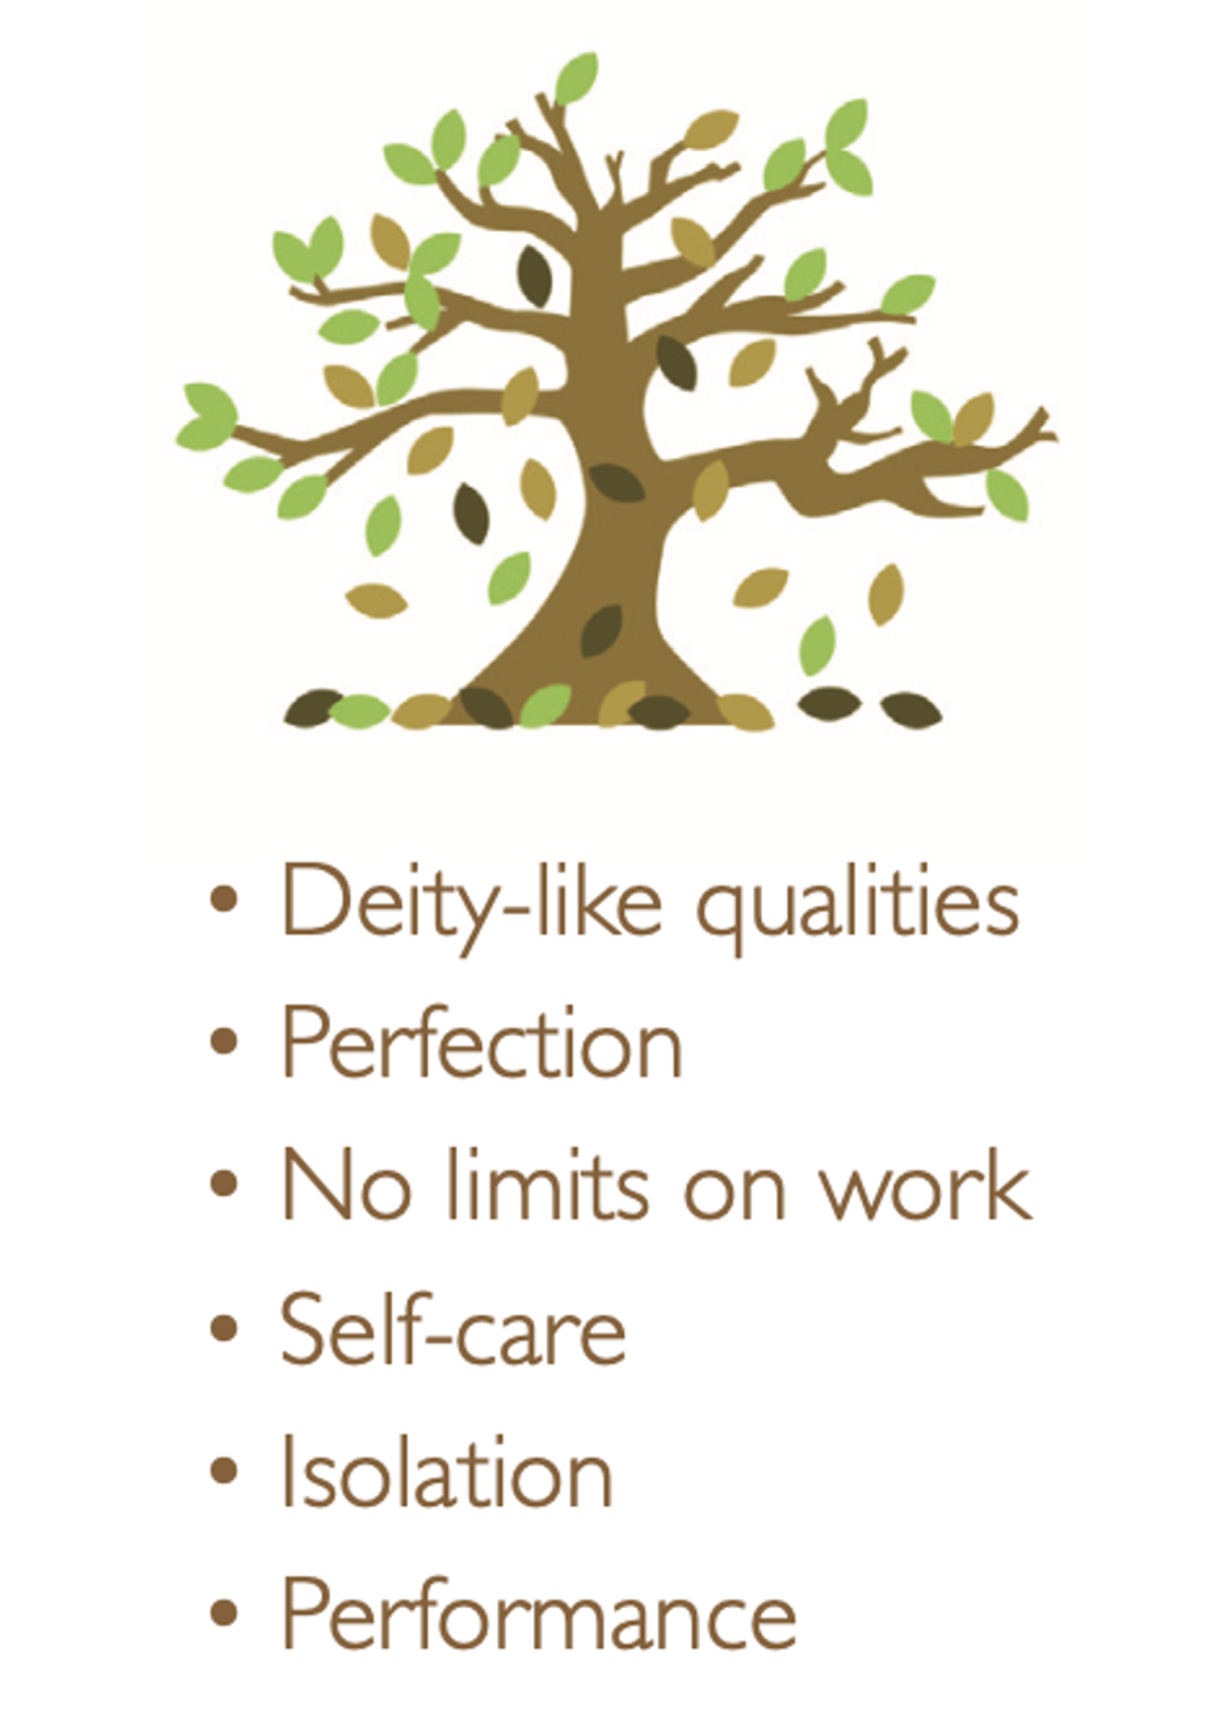
Era of distress
Pre-2005
Physician with superhuman, deity-like qualities
No limits on work
Medical school and training mindset was a rite of passage
Lack of awareness
Individual distress neglected or ignored
Distress was often viewed as a personal weakness and the physician uncommitted
Inattention to impact of clinician distress on patient care

Slide 5
Era of distress
Cascade Family Medical Clinic
Centralia, WA

Slide 6
Dimensions of Physician/APP Distress
Personal
Depression
Anxiety
Substance Use
PTSD
Occupational
Burnout
Moral Distress/Injury
Work-life Balance

Slide 7
Causes of Workplace Distress
Long hours and demanding schedules
Emotional stress – dealing with critically ill patients, death, difficult medical situations
Poor work-life integration
Loss of public trust
Loss of trust in the healthcare system
Decreased autonomy & control
Decreased time with patients
Feeling undervalued by the health system
Increased regulatory & documentation requirements
Electronic Health Record – inefficient and intrusive
Isolation
Moral Distress

Slide 8
Burnout
Syndrome of occupational distress
Emotional exhaustion
Low personal accomplishment at work
Depersonalization (loss of empathy, negative attitude towards patients)

Slide 9
National Statistics
48.2% national physician burnout rate – AMA 2023
20% of physicians with clinical depression – Medscape Report 2024
>30% depressed: urology, FM, IM, EM, OB/GYN, PM&R – AMA data 2021
16% of physicians have had suicidal ideation - Medscape Report 2025
66% stated that work played a dominant or major role
70% of NPs are burned out or depressed – Medscape Report 2024
37% burned out, 5% depressed, 28% burned out & depressed
64% of PAs are burned out or depressed – Medscape Report 2024
35% burned out, 6% depressed, 23% burned out & depressed

Slide 10
National Statistics - Burnout

Slide 11
AMA Organizational Biopsy
Results to be reported June 2025
Compare to national benchmarks
4 Domains
Organizational Culture
Practice Efficiency
Self-care
Retention

Slide 12
Impact of Burnout

Slide 13
Cost of Turnover
$1 Million/physician
3x Salary/APP
Interview expense (average $30,000/candidate - NEJM-Jackson Physician Search)
Sign-on Bonus & Relocation Allowance
Student Loan Repayment
Salary support while ramping up
Revenue loss during vacancy
Family Medicine generates $2.11 million/year net revenue for hospitals (Merritt Hawkins 2022)
$175k/month until replaced
Average 4.5 months to replace FM physician
Interventional Cardiology $3.48 million/year
$290k/month until replaced
Average 5-10 months to replace a specialist

Slide 14
AMA Cost of Turnover Calculator

Slide 15
Vicious Cycle of Burnout
Burned out clinicians are self-focused – trying to survive
Patient safety, quality, teamwork suffer
Productivity decreases
Clinicians lose trust that leadership cares about their professional lives and experience
Burnout worsens
Clinicians reduce FTE, leave the organization, leave healthcare altogether

Slide 16
Professional Impact of Burnout

Slide 17
Professional Impact of Burnout
Wellness & health system improvements are inextricably linked
All major clinical initiatives should consider & factor-in physician well-being

Slide 18
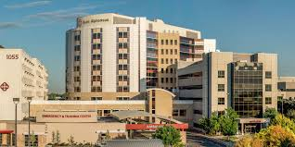
Solutions
Organization/System
Individual
80%
20%

Slide 19
Dr. Glaucomflecken

Slide 20
Physician Resiliency
Resilience scores higher in US physicians than the general population in 2017-2018 (n = 10,643)
Each 1 point increase in resiliency score was associated with a 36% decreased chance of burnout (OR = 0.64)
29% of physicians with the highest resiliency scores were still burned out

Slide 21
Personal Wellness
Personal Wellness
Self-care – sleep, exercise, nutrition, stress reduction
Relationships – personal and work colleagues
Religious/spiritual practice
Hobbies
Financial well-being
Work-life integration
Optimize Meaning in Work
Spending >20% of time at work that is the most meaningful is
associated with a 50% decrease in burnout

Slide 22
Work-life Balance
Shanafelt, et al. Pending publication 2024

Slide 24
Work on PTO/vacation
3,024 physicians surveyed
70% performed patient care tasks on vacation
Only 49% had full EHR inbox coverage
60% took less than 15 days of vacation
20% took less than 5 days
44% decreased risk of burnout if taking >15 days of vacation/year
26% decreased risk of burnout if have full EHR inbox coverage on vacation
Burnout almost doubles if working more than 60 minutes/day on vacation

Slide 25
Resources
EAP Program & Spring Health (clinician & family)
EAP Boise – 208-367-3300 https://benefits.springhealth.com/customer/trinity-health
6 free sessions per year
6 free coaching sessions per year
SAMG Peer Support
6 clinicians trained (physicians, APPs, primary care & specialty)
Robert Perko, MD robert.perko@saintalphonsus.org
Physician Vitality Program - Ada County Medical Society
https://www.physicianvitality.org
5 free sessions per year

Slide 26
Physician/APP Wellness Committee
Formed in 2022
Reports to the Leadership Council
Members include physicians, APPs, senior SAMG leadership
Develop a strategy to address burnout and improve well-being

Slide 27
Stanford Well-being Model
Wellness Centered Leadership
Communication/transparency
Recognition/Appreciation
Values alignment
Community
Peer support
Culture of compassion
Input & voice
DAX co-pilot AI documentation
MyChart message management
Epic In-basket management
Team based care

Slide 28
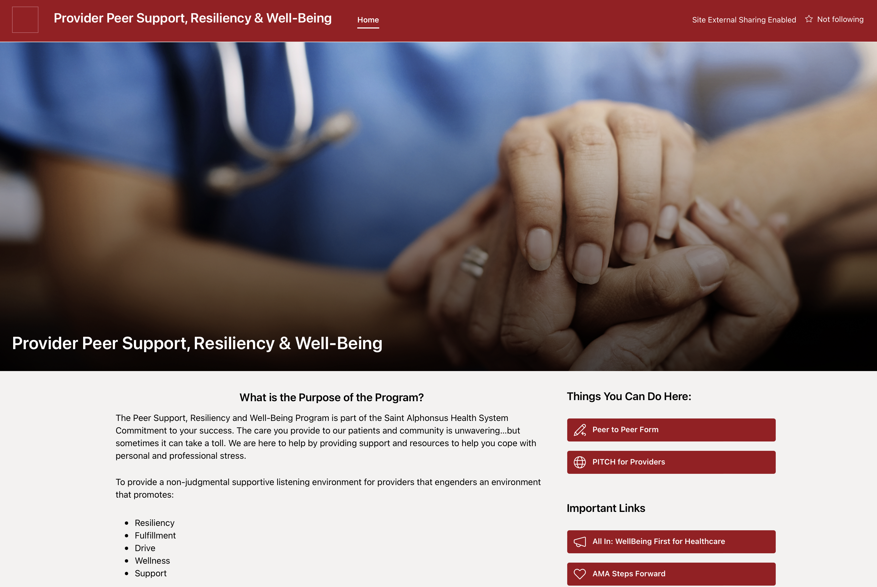
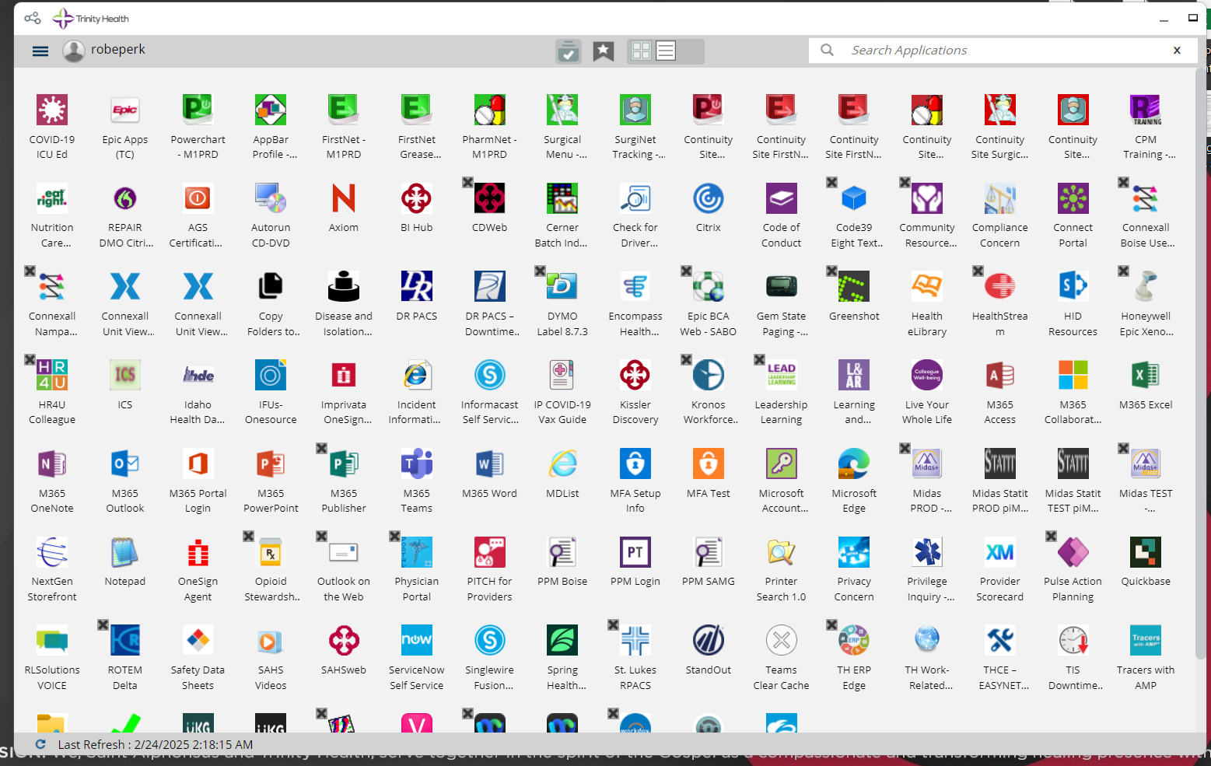
PITCH Program
P - Provider
I - Input
T - Through
C - Colleague
H - Help

Slide 29
PITCH Program
P - Provider
I - Input
T - Through
C - Colleague
H - Help

Slide 30
Wellness Centered Leadership
Every 1 point increase in composite leadership score is associated with a 3.3% decrease in burnout

Slide 31
Wellness Centered Leadership

Slide 32
Stay Interviews
Proactive interview
Reasons that you stay with the organization
What do you look forward to at work?
What keeps you here?
If you could change something about your job, what would it be?
What would make your job more satisfying?
What motivates (or demotivates) you?
What can I do to best support you?
How do you like to be recognized?

Slide 33
Cultivate Community
Social Connection
Private Well-being Website, Social Media Site, Teams Channel
Clinician/family events
Commensality Dinners
6-8 physicians/APPs meet monthly for 6 months
Discuss a question regarding the virtues & challenges of being a clinician
Build comradery
Gain perspective from each other
Cultivate meaning in work

Slide 34
Department/Clinic Level Improvement
Participatory Leadership:
Listen-Sort-Empower
-Active Inquiry
-Focus Groups
-Pulse surveys
-Engage team to find pebbles in your shoes
-Empower physicians/APPs to solve problems
-Develop and Operationalize Change
-Reassess
Critical component of physician leadership is to engage & empower physicians/APPs
Breeds engagement & collaboration
Avoid mistake of over-generalizing for all clinics/departments
“It isn’t the mountains ahead to climb that wear you out, it’s the pebbles in your shoes.”
-Muhammad Ali

Slide 35
Well-being 2.0

Slide 36
Well-being 2.0

Slide 37
Summary
Efforts at the system/organizational level are just beginning
Reach out to Wellness Committee members with suggestions/ideas
Work with your leaders on clinic/department level efficiencies & process improvement
Don’t neglect personal wellness
Find what is most meaningful in work and strive to carve out time to do that work (ideally >20% of the time)
Reach out for support if needed

Slide 38
Questions?

