Slide 1
Boomers, Gen Xers and Millennials…Oh My! Intergenerational Communication in the Workplace
Lisa Nelson, MD, FACP
Medical Director of Medical Education, SAHS
April 11, 2025

Slide 2
Let’s Go to Work!

Slide 3
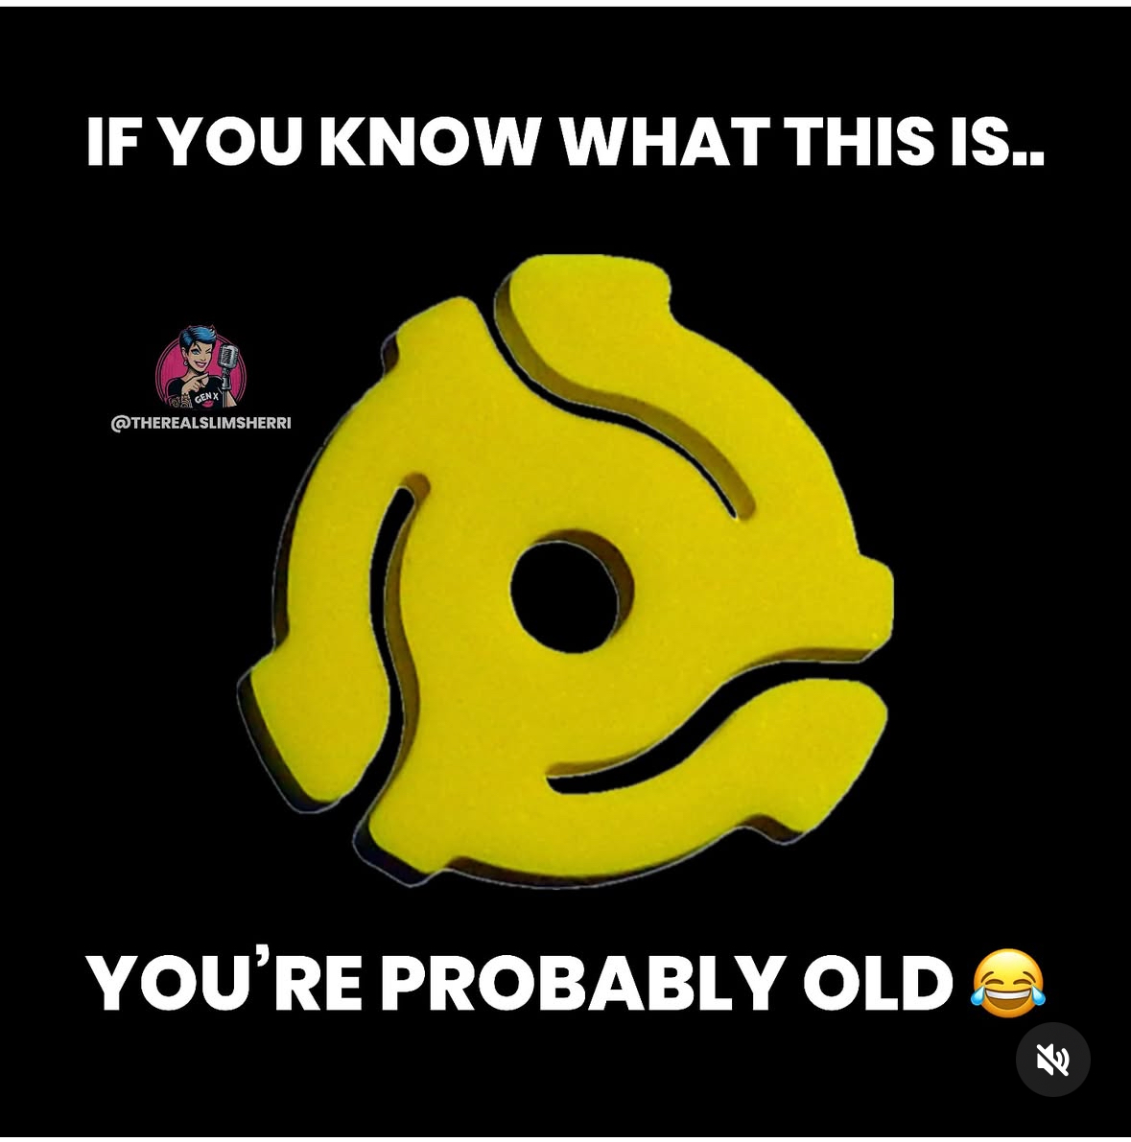
Goals and Objectives
Understand defining characteristics and shared experiences of Baby Boomers, Generation X, Generation Y (Millennials) and Generation Z
Understand communication styles and preferences for each generation
Consider barriers to effective intergenerational communication
Develop strategies for improving communication between generations

Slide 4
Effective communication saves lives and prevents harm

Slide 5
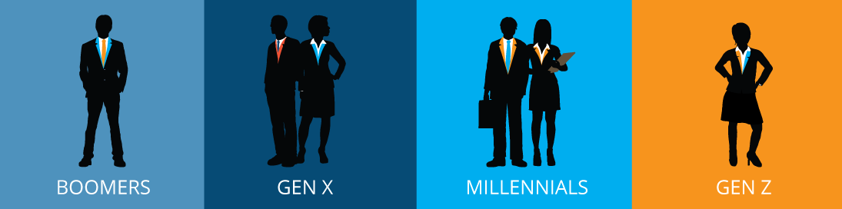
The Multigenerational Healthcare Workforce
Four Generations
Unique Values
Challenges & Opportunities
Four generations are currently in the workforce. These generations include Baby Boomers, Generation X, Millennials (Generation Y) and Generation Z.
Each generation possesses unique values. They also have distinct communication styles and work approaches.
Generational diversity creates both challenges and opportunities. These impact team dynamics and patient care.

Slide 6
Challenges in Intergenerational Communication
Stereotyping
Differing expectations
Communications Preferences
Slacker
Workaholic
Clueless
Out of touch
Older people can’t change
Young people are lazy
Loyalty to employer
Work-life balance
Leadership structure and expectations
Feedback
Face to face
Phone call
Email
Text/IM
Video conference
Social media

Slide 7
Benefits of Effective Intergenerational Communication
Improved Collaboration
Knowledge Transfer
Improved team collaboration leads to better care. Communication errors are reduced with understanding.
Bi-directional knowledge transfer and mentorship. Diversity of viewpoints.
Increased Satisfaction
Increased job satisfaction and retention rates. Employees feel valued and connected to the team.

Slide 8
Baby Boomers

Slide 9
Baby Boomers
Demographics
Born between 1946 and 1964. Currently aged 61 to 79 years old.
Experiences
Grew up during economic prosperity and marked social change.
Characteristics
Grew up in homes with working dads and stay at home moms. Have seen tremendous advances in technology. Known for being workaholics.

Slide 10
Baby Boomers: Key Communication Characteristics
Direct
Detailed
Prefer direct and straightforward communication.
Value detailed explanations and full context.
Formal
Appreciate formal language and professional etiquette.

Slide 11
Preferred Communication Methods
Face-to-Face
Phone Calls
E-mail
Value personal connections and direct interactions.
Comfortable with detailed phone conversations.
Email is secondary, for formal communication and documents.

Slide 12
Communication Challenges
Technology Resistance
May resist newer communication technologies.
Detailed Discussions
Preference for longer, more detailed discussions.
Informality
May view informal communication as unprofessional.

Slide 13
Effective Communication Strategies
Schedule Meetings
Provide Context
Schedule face-to-face meetings when possible.
Provide context and background information.
Use Formal Language
Use a formal language and a professional tone.

Slide 14
Generation X

Slide 15
Generation X
Demographics
Adaptable
Analog & Digital
Self-Reliant
Born between 1965 and 1980. Currently aged 45 to 60 years old.
Known for their adaptability in changing environments.
Experienced both analog and digital revolutions firsthand.
Highly self-reliant and resourceful problem solvers.

Slide 16
Key Communication Characteristics
Efficiency
Value efficiency and convenience in all interactions.
Conciseness
Prefer straightforward, clear, concise messages.
Etiquette
Appreciate professional etiquette and respect.

Slide 17
Preferred Communication Methods
Email
Top choice for over 50% due to its efficiency.
Phone Calls
Prefer 1:1 for personal connection and immediate feedback.
Face-to-Face
Value in-person for clearer communication.
Digital Comfort
Comfortable with digital tools, but not always their primary choice.

Slide 18
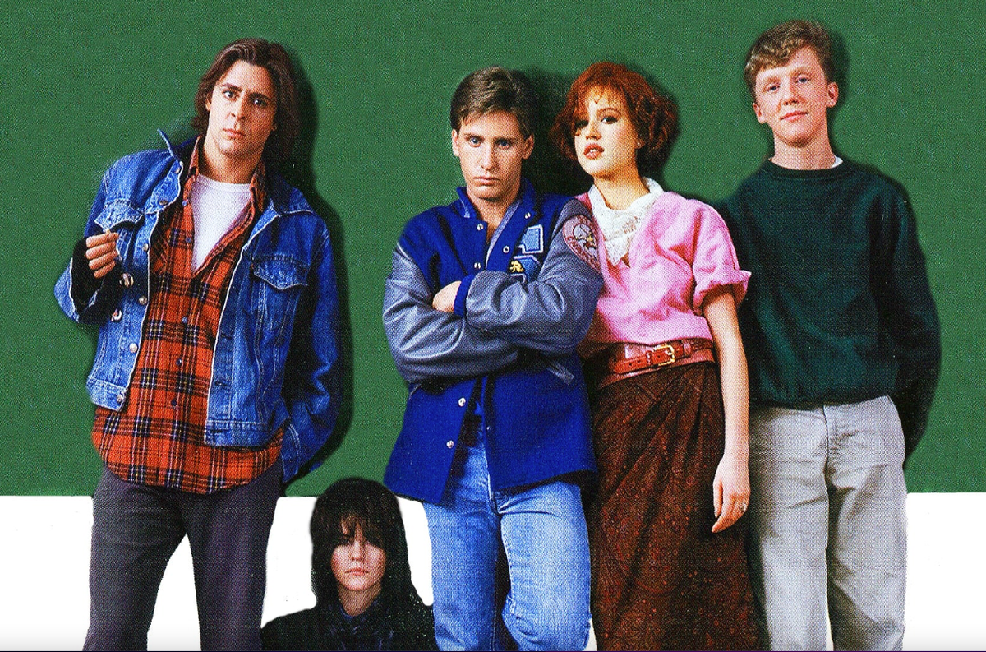
Communication Challenges
Avoidant
Tend to avoid conflict and disagreement
Results driven
Less tolerant of those who are not prepared or focused
Fiercely Independent
Feedback is fine, but don’t like to be “micromanaged”

Slide 19
Generation X: Strategies for Effective Communication
Mix Methods
Use a blend of digital and
traditional methods
Be Brief
Keep messages concise
and to the point
Allow for Flexibility
Respect their time and
independence

Slide 20
Generation Y (Millennials)

Slide 21
Generation Y (Millennials)
Demographics
Turn of the Century
Digital natives
Born between 1981-1996. Currently aged 29 to 44 years old.
This generation is often referred to as “Millennials” due to their coming of age around the turn of the millennium.
Having grown up with technology, they are considered digital natives.

Slide 22
Key Communication Characteristics
Tech Savvy
Instant communication
Brevity is natural
Informal tone
Expect and want immediate feedback

Slide 23
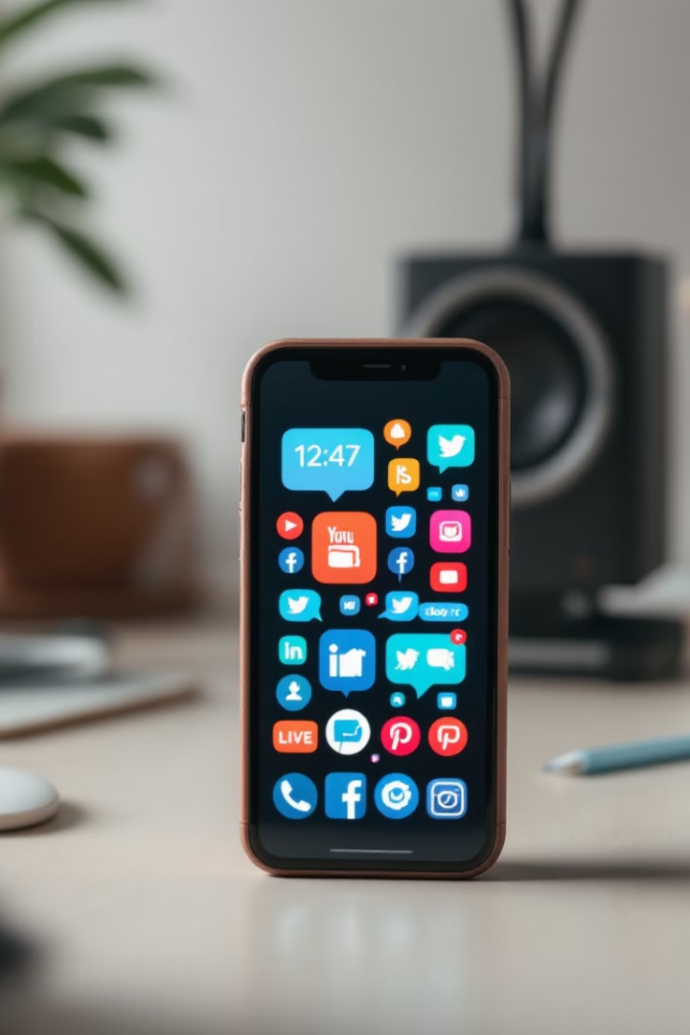
Preferred Communication Methods
Texting
Social Media
Email
Text messaging and instant messaging apps are their primary tools.
They are active on various social media platforms.
Email is reserved for more formal communication.
Video Calls
Video calls are used for face-to-face interactions.

Slide 24
Generation Y: Communication Challenges
Short Attention Spans
They have relatively short attention spans.
Immediate Responses
They expect immediate responses to their queries.
Miscommunication
Text-based formats can lead to miscommunication.
Personal Boundaries
Balancing personal and professional boundaries is crucial.

Slide 25
Millennials (Generation Y): Communication Strategies
Leverage technology
Use multiple channels
Provide context
Set boundaries and expectations
Provide regular feedback
Be open, honest and transparent. Encourage 2-way communication

Slide 26
Generation Z

Slide 27
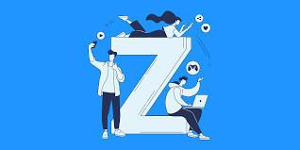
Generation Z
Demographics
Key Traits
Born between 1995 and 2012
Currently aged 13 to 20
Gen Z is known for its tech-savviness. They are adept at navigating, and rely on, the digital world. Prioritize living comfortably and having work-life balance over a “dream job” or high work status.

Slide 28
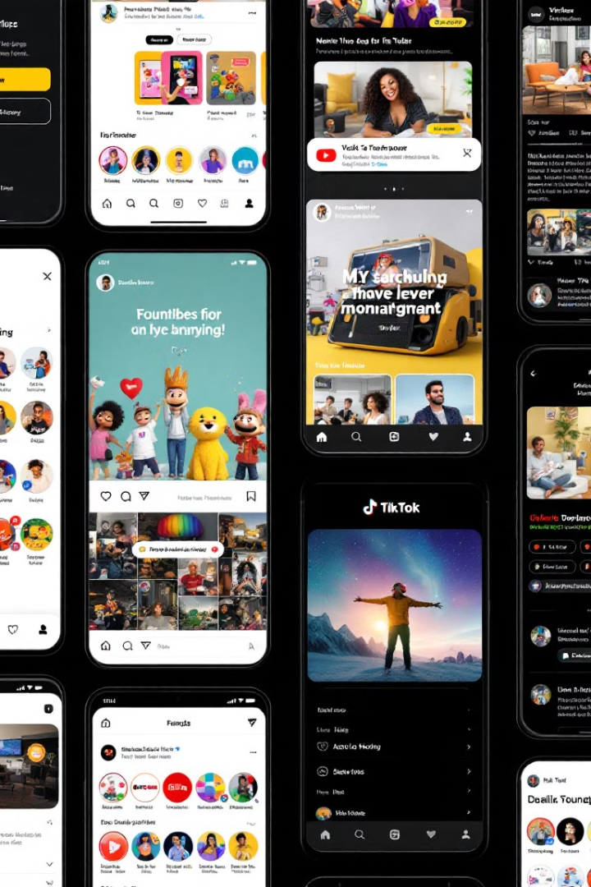
Key Communication Characteristics
Concise and Visual
Gen Z prefers short, engaging content. Visuals capture their attention.
Instant Messaging
Favor quick, direct communication through platforms.
Multi-Platform Engagement
Gen Z is active across various social media channels.
Authenticity and Transparency
Value honesty and openness in communication.

Slide 29
Preferred Methods of Communication
Text, instant message
Social media (video format)
Value personal interaction and want face-to-face interaction
Prefer informality and horizontal leadership structures

Slide 30
Generation Z: Communication Challenges
Underdeveloped “soft” or interpersonal skills
Short attention span
Lack of access to instant information
Loss of context in brief written communications
Email is an afterthought

Slide 31
Strategies for Effective Communication
Authentic Messaging
Be genuine and transparent to build trust
Visual First Content
Prioritize images and videos to capture attention
Embrace emerging platforms
Adapt to new technologies and channels
Bite sized information
Break up larger subjects and provide activity-based learning opportunities
Instant Feedback
Provide quick responses and engagement opportunities

Slide 32
We Are Better Together
“Each generation imagines itself to be more intelligent than the one that went before it, and wiser than the one that comes after it.”
-George Orwell

Slide 33
Thank You!

Slide 34
References
Abril, D. Washington Post. Gen Z workers can take criticism. You’re just phrasing it wrong. Accessed August 19, 2024
Bell, JA. Five Generations in the Nursing Workforce. Journal for Nurses in Professional Development. 2013. 29(4): 205-210.
Betz, CL. Generations X, Y and Z. Journal of Pediatric Nursing. 2019. 44:A7-A8.
Eckleberry-Hunt J, Lick D, and Hunt R. Is Medical Education Ready for Generation Z?. Journal of Graduate Medical Education. 2018. (8): 378-381
Giunta, C. An Emerging Awareness of Generation Z Students for Higher Education Professors. Archives of Business Research. 2017;5(4):90-104.
Mohr, KAJ and Mohr, ES. Understanding Generation Z Students to Promote a Contemporary Learning Environment. Journal on Empowering Teaching Excellence. 2017. 1(1): 84-94.
Pawlak N, Serafin L, Czarkowska-Paczek . Analysis of the influence of intergenerational differences on cross-generational cooperation among nurses. B. JOURNAL. 2022 21(1) 45-49.

Slide 35
References
Heuss, SC, Zimmerli L and Schneeberger AR. How do physicians from two generations communication with each other? Cogent Social Sciences. DOI: 10.1080/23311886.2022.2095745
Rohrich, RJ and Dayan, E. Improving Communication with Millennial Patients. PRS Journal. 2019. DOI: 10.1097/PRS0000000000005857
Shorey S, Chan V, Rajendran P, and Ang E. Learning Styles, preferences and needs of Generation Z healthcare students: Scoping review. Nurse Education in Practice. 2021. 57:1-11.
Spressart, J. Mind the Gap: Leadership Across Generations. Law Practice. 2022;48(6).
Stutzer, K. Generational Differences and Multigenerational Teamwork. Critical Care Nurse. 2019; 39(1):78-81.
Waldman E. How to Manage a Multi-Generational Team. Harvard Business Review. 31 August 2021.
Wieck, KL. Motivating an Intergenerational Workforce. Orthopaedic Nursing. 2007; 26(6):366-371
Generation Z - Learning and Teaching Hub accessed August 19, 2024

