Slide 1
Research Institute at Saint Alphonsus – Neuro
Presenter: Helena Snider, CRC II - Neuroscience ☺ (AKA: Sharonrose Snider)

Slide 2
Agenda
Welcome everyone! Thank you for being here today.
Who – Who is your Neuro Research team at Saint Alphonsus?
What – What is Clinical Research?
Where - Where is Saint Alphonsus Neuro Research making a difference?
When – When did the Research Institute begin at Saint Alphonsus?
Why – Why is Neuro Research important?
How to make the difference in your community?

Slide 3
Neuro Research Team ☺
Neuro research email: neuro.research@saintalphonsus.org
Current Neuro Clinical Research Coordinators (CRCs):
Helena Snider (208) 367-7397 Helena.snider@saintalphonsus.org
Westin Payne (208) 367-7017
westin.payne@saintalphonsus.org

Slide 4
Who: Current Research Clinical Staff
Dr. Lukas Clark
Jane Spencer, CNS
Dr. Jackie Whitesell
Dr. Ondrej Choutka
Carin Bohan, PA
Chris Oswald
Amber Enochson
Erik Schumacher
Huge THANK YOU to all clinical and supporting staff!
Additional Research Institute team members:
Alicia Weeks – Ortho
Erika Calhoun – Cardio
Kristina Slanda - Cardio
Suzanne Janzen - TMIST
Madelyn Pierce - Onc
Janine Wiese - Onc
Shauna M. Boren - Onc
Mrunmayi Tilak - Onc
Stacie Smith – Manager, HRPP
Julie Bird – Research Ops
Marcy Martens – Finance
Dr. Born – Chief Medical Officer
Westin Payne – Neuro
Helena Snider – Neuro

Slide 5
Phases of Clinical Trials:
What is Research?
Phase 1: (15-50 participants) Focus on safety and the proper dose.
*Phase 2: (Less than 100 participants) Focus on effectiveness and side effects.
*Phase 3: (Hundreds of participants) Compares the new treatment to existing treatment.
*Phase 4: (Thousands of people) Treatment is approved and available. Long-term effects are observed.
→ Registry studies
https://www.cancer.nsw.gov.au/research-and-data/cancer-clinical-trials-in-nsw/how-do-clinical-trials-progress
= Phases Saint Alphonsus is most engaged in

Slide 6
Types of Research: (Short List)
Not here “Yet”
Investigator led research – Not currently available for Neuro Research. However, send feasibility for review.*
Academic Research – ID does not have a medical research academic center. However, future engagement of local partners and related learner groups are in development.*
Here now
Industry sponsored trials – Privately funded trials.
Federally funded trials – Use of federal dollars/grants for research.
Registry studies – A type of observational study. Data is collected more inline with clinic standards
Observational studies – More scheduled study follow-up timepoints to observe and collect health outcomes
Interventional studies – Strict treatment and study follow ups; compete and align with standard of care for patient interventions.
Common Research Coordinator Tasks:
Conducting informed consent
Reviewing patient EMR for Eligibility
Performing pt health questionnaires
Detailed understanding of a protocol
Review lab/ Imaging results
Record concomitant meds/procedures
Reporting Adverse Events/ Serious Adverse Events
Muscle Testing (HHD/Jamar)
Vitals
Spirometry vital capacity testing
ALSFRS
Cognitive testing (ECAS)
Coordinating patient appointments
Blood draws
Lab processing
Sample shipping/ BioBanking
Modified Rankin Scale
ECG
Medication review
Medication compliance
Register/Randomization
Admin/Finance/Data
Policy/ Regulatory Compliance
Metric Capture
EPIC Everything
Patient Education
Patient Navigation across PNW

Slide 7
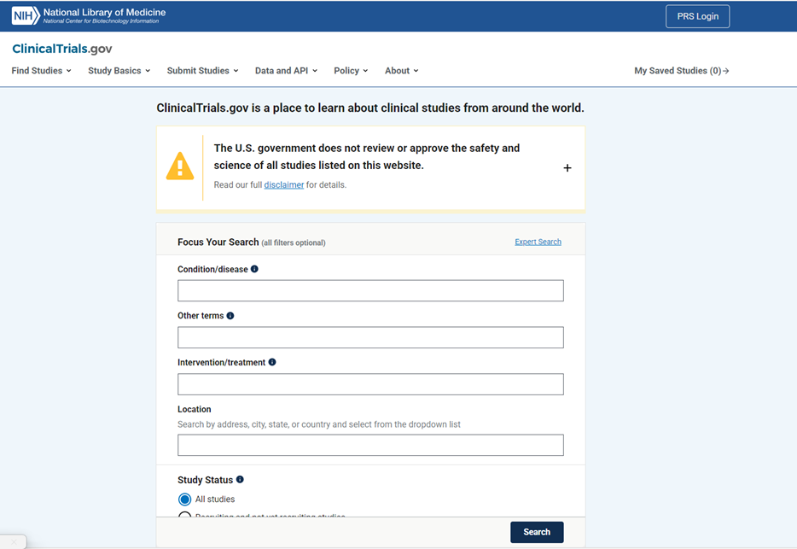
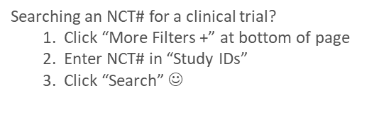
Where to find Trials:
ClinicalTrials.gov
Current Neuro Research NCT# at Saint Alphonsus:
CorEvitas: NCT03291756
ASSESS: NCT06578195
PREVENT: NCT06581861
Healey Platform: NCT04297683
Healey RGF: NCT05740813
Librexia: NCT05702034
ASPIRE: NCT03907046
GammaTile: NCT04427384

Slide 8
Current Studies:
ASPIRE (Anticoagulation in ICH Survivors for Stroke Prevention and Recovery) NCT#: NCT03907046 (New!) Consortium: NIH StrokeNet https://www.nihstrokenet.org/ Study Summary: A randomized, double-blinded, phase III clinical trial designed to test the efficacy and safety of anticoagulation (apixaban) , compared with aspirin, in patients with a recent ICH and non-valvular AF. →PI: Dr. Lukas Clark, Sub-PI: Jane Spencer
ASSESS ALL ALS Study NCT#: 06578195 (New!) Consortium: All/ALS Consortium Study Summary: Longitudinal Biomarker Study for Symptomatic ALS and Control patients. → PI: Dr. Jackie Whitesell Current Site enrollment: 2*
PREVENT ALL ALS Study NCT#: 06581861 (New!) Consortium: ALL/ALS Consortium Study Summary: Longitudinal Biomarker Study for Participants Who Are Genetically At Risk for Amyotrophic Lateral Sclerosis (ALS) → PI: Dr. Jackie Whitesell Current Site Enrollment: 1*
Librexia A Study of Milvexian in Participants After an Acute Ischemic Stroke or High-Risk Transient Ischemic Attack- LIBREXIA-STROKE NCT#: NCT05702034 Study Summary: The purpose of this study is to evaluate whether milvexian compared to placebo reduce the risk of recurrent ischemic stroke. →PI: Dr. Lukas Clark, Sub-PI: Jane Spencer Current site enrollment: 2*
Healey ALS Platform Trial Master Protocol, Regimens E, F, G (Placebo & Active) NCT#: 04297683 Study Summary: Multi-Regimen clinical trial evaluating the safety and efficacy of investigational products for the treatment of ALS. → PI: Dr. Jackie Whitesell, Sub-PI: *** Current site enrollment: 3
CorEvitas Multiple Sclerosis Registry NCT#: NCT03291756 Study Summary: This prospective, non-interventional research registry is designed to study the comparative effectiveness and comparative safety of approved treatments for MS in a cohort of patients cared for by neurologists across North America. Secondary objectives include analyzing the epidemiology and natural history of the disease, its comorbidities, and current treatment practices. → PI: Dr. Jackie Whitesell, Sub-PI: *** Current site enrollment: 22*
STaRT GammaTile Registry NCT#: NCT04427384 Study Summary: The objectives of this registry study are to evaluate real-world clinical outcomes and patient reported outcomes that measure the effectiveness and safety of STaRT. → PI: Dr. Ondrej Choutka, Sub-PI: Carin Bohan, NP Current site enrollment: 7*

Slide 9
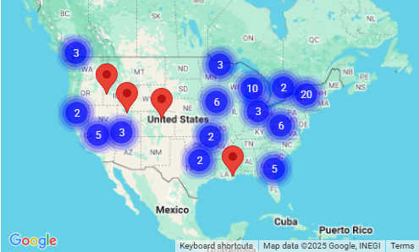
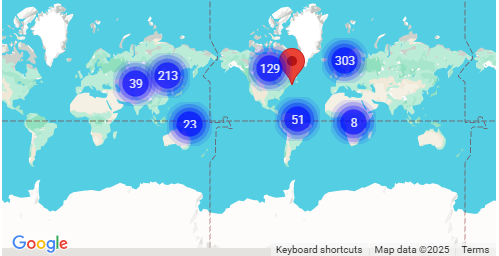
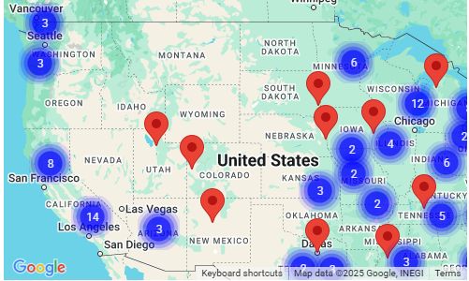
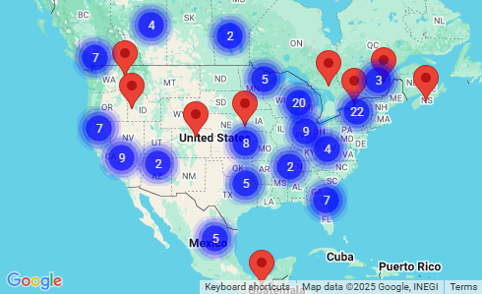
Our Mark on the World of Research
A)
ALL & ALS Consortium – ASSESS & PREVENT- ALS Biomarker Study Boise, ID!! ☺
D)
Healey Platform Trial - ALS Treatment trial Boise, ID!!
B)
E)
The Whole world→
C)
Librexia Trial - Acute ICH Boise, ID!! ☺
StrokeNet Consortium - ASPIRE: ICH w/ non-valvular Afib Boise, ID!!

Slide 10
When….
Research started at Saint Alphonsus around ~2010.
Currently our staff has over 90+ years of clinical research experience.
Neuro Research officially became a “team” in 2024. ☺ Combined experience is over 90+ years of clinical trials in a variety of indications.
4 service lines: Cardiology, Oncology, Orthopedics, and Neurology
The “Lore” of research - (Some light reading):
The Nuremberg Trials
Tuskegee Experiment
Cytokine Storm
The Declaration of Helsinki
Sulfanilamide Disaster
Thalidomide
The Belmont Report
Jesse Gelsinger

Slide 11
Why Research?
Objectively: Research done to improve patient care, develop new treatments, provide access to novel therapy not yet on the market, understand how to prevent and manage disease (both future and existing).
Subjectively: Participation in something that provides autonomy and a sense of “legacy” for participants during their medical journey. Research allows patients and caregivers to have an option of possible hope to their care.
NIH Mission Statement: “Clinical research is vital to the National Institutes of Health (NIH) mission of enhancing health, lengthening life, and reducing the burdens of illness and disability.”

Slide 12
How YOU can make the difference
Become Educated
Share experiences
Readings (The immortal life of Henrietta Lacks, Letters from Auschwitz, Jesse’s Intent, The Center Cannot Hold).
Engage in the process
Consider as a possible option during patient care
Refer possible patients to CRCs for deep dive into screening
Do not be intimidated by the process
Consider a role as a Primary Investigator or a Sub-Investigator
Complete required CITI training
Inquire about current opportunities
Share interest in specific area or visit clinicaltrials.gov
Bring us trials that were mentioned at conferences or other academic forums.
Always feel free to reach out to your neighborhood CRC a research inquiry!

Slide 14
References/ Resources:
https://www.cancer.nsw.gov.au/research-and-data/cancer-clinical-trials-in-nsw/how-do-clinical-trials-progress
Clinicaltrials.gov https://clinicaltrials.gov/
The Nuremberg Trials: https://nuremberg.law.harvard.edu/nmt_1_intro
The Declaration of Helsinki: https://pmc.ncbi.nlm.nih.gov/articles/PMC1995496/
Tuskegee Experiment: https://www.history.com/news/the-infamous-40-year-tuskegee-study
Sulfanilamide Disaster: https://www.fda.gov/files/about%20fda/published/The-Sulfanilamide-Disaster.pdf
Cytokine Storm: https://www.nejm.org/doi/full/10.1056/nejmoa063842
Thalidomide: https://academic.oup.com/toxsci/article-abstract/122/1/1/1672454?redirectedFrom=fulltext
The Belmont Report: https://www.hhs.gov/ohrp/regulations-and-policy/belmont-report/index.html
Jesse Gelsinger: https://pmc.ncbi.nlm.nih.gov/articles/PMC81135/

Slide 15
Neuro Research e-mail: neuro.research@saintalphonsus.org
THANK YOU! ☺
Notes:
Thank you all <3

