Slide 1
Updates and Advances in Epilepsy: Diagnosis and Treatment for Primary Care
Dr. Erik Valenti, MD Neurology Epilepsy

Slide 2
Disclosures
No disclosures

Slide 3
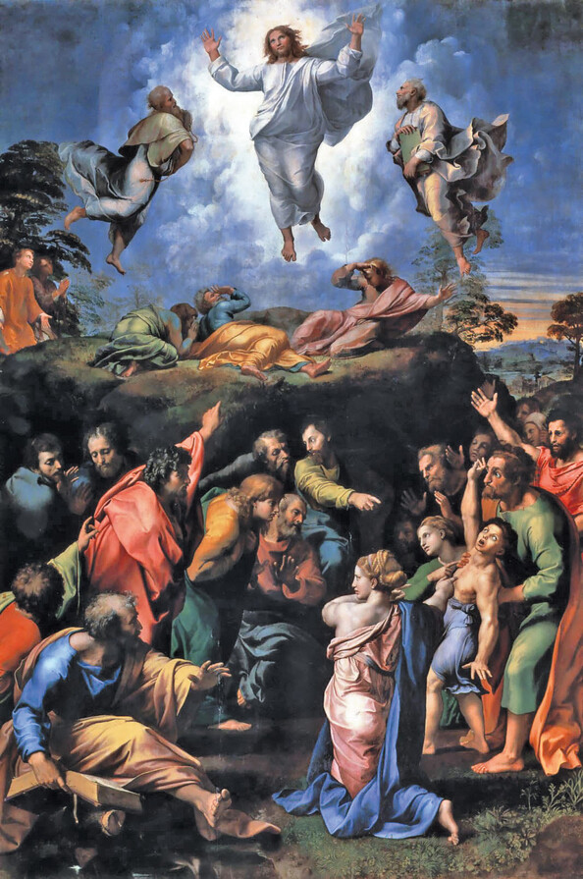
Overview
Definitions of Epilepsy and Seizures
Updates of 2017 International League Against Epilepsy (ILAE) Epilepsy Definitions
Overview of Types of seizures and epilepsy
Management of first lifetime seizure
Recommended Treatment options for epilepsy
New Epilepsy treatments now and in the future

Slide 4
Definition
Epileptic Seizure (ILAE definition): “a transient occurrence of signs and/or symptoms due to abnormal excessive or synchronous neuronal activity in the brain.”³
I.e. a symptom or single event
Epilepsy:
“a disorder of the brain characterized by an enduring predisposition to generate epileptic seizures and by the neurobiologic, cognitive, psychological and social consequences of this condition³
Disease /disorder definition

Slide 5
Epilepsy Definition (cont.)
“At least two unprovoked seizures separated by more than 24 hours
OR one unprovoked (or reflex) seizure, coupled with a probability of further seizures that is similar to the general recurrence risk (at least 60%) after two unprovoked seizures projected over the next decade
i.e. one seizure AND risk factors for epilepsy
OR seizure consistent with an epilepsy syndrome”¹

Slide 6
Risk Factors⁵
Stroke (cortical)
Prior TBI (with imaging changes)
CNS infection (history of meningitis or encephalitis)
Childhood seizures
Childhood epilepsy
History of complex febrile seizure
Family history of epilepsy (first degree relative)

Slide 7
Step 1: Take a History!
History, History, History
Ask about semiology
Aura?
Eyes open/closed. Gaze deviation?
Arm and leg movement? Simultaneous or one side before the other?
Urinary or fecal incontinence?
Tongue biting?
Tip or side?
Duration
Post-ictal period / behavior
Triggers? Illness? Head injury? Medication use? Substance use? Alcohol?

Slide 8
BEWARE: Seizure mimics
Always have a differential
“Not all that convulses is a seizure.”
- Dr. Erik Valenti
Not all seizures are convulsive
Mimics:⁶
Convulsive syncope
Cardiac: Arrhythmia, Orthostatic hypotension
Metabolic: Hypoglycemia
Stroke
Functional / PNES
Sleep disorder
Movement disorder: tremor, dyskinesia
Encephalopathy

Slide 9
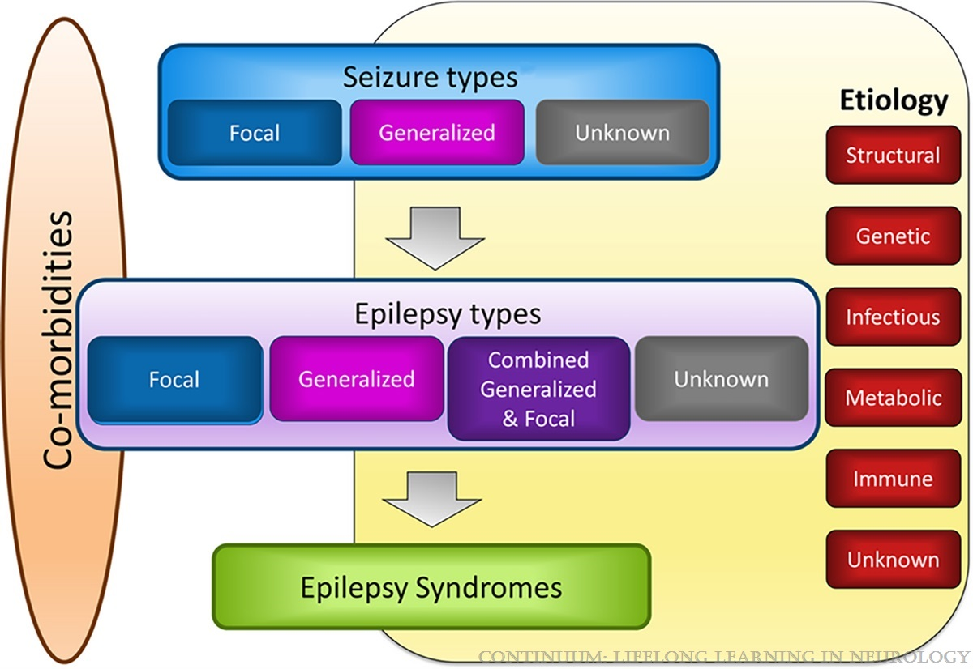
Framework for Epilepsy Types
Classification of the epilepsies by the International League Against Epilepsy.Reprinted with permission from Scheffer IE, et al, Epilepsia.10 © 2017 International League Against Epilepsy.

Slide 10
Types of Seizures⁸
“Old” ILAE 1989 Classification
Partial seizures
Simple Partial seizure
Complex Partial seizure
Generalized seizures
Absence
Atypical absence
Tonic
Tonic-clonic
Clonic
Updated ILAE 2017 Classification
Focal seizures
Focal Aware seizure
Focal Impaired awareness Seizure
Generalized seizures
Motor
Non-motor

Slide 11
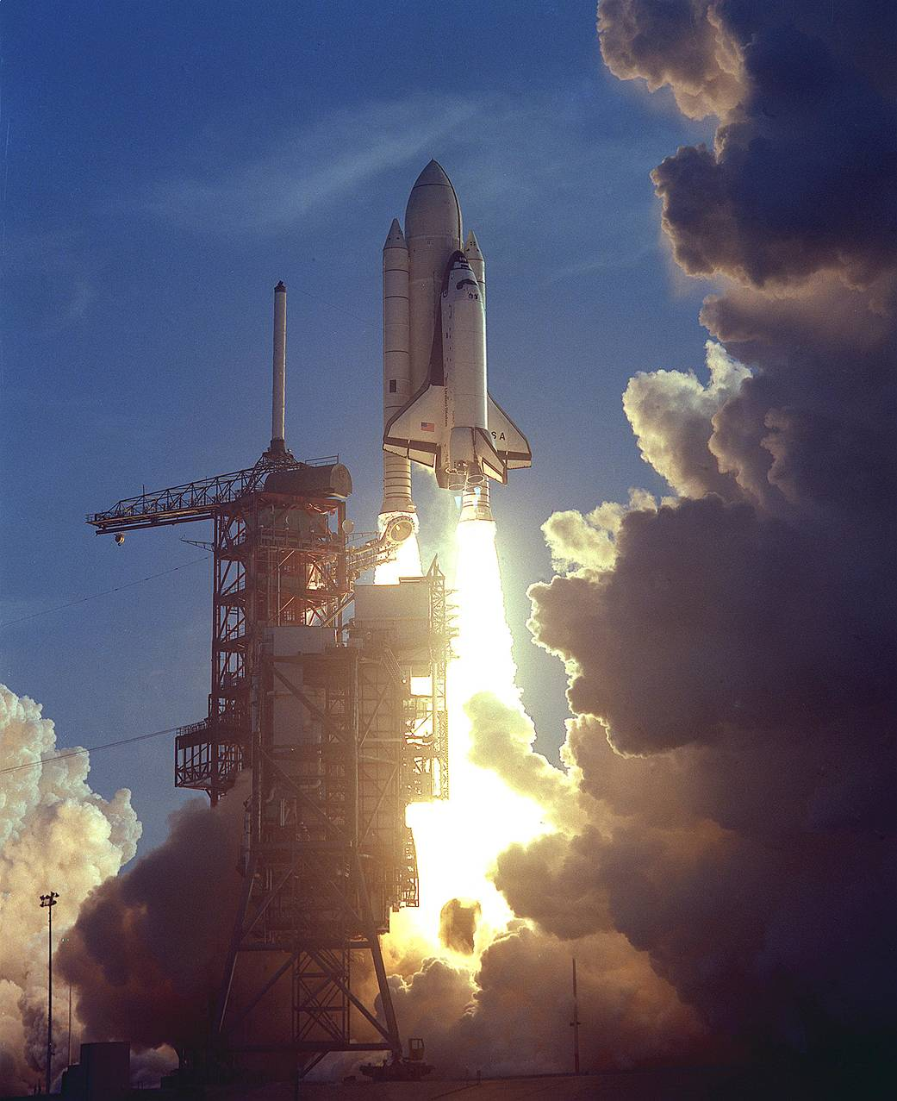
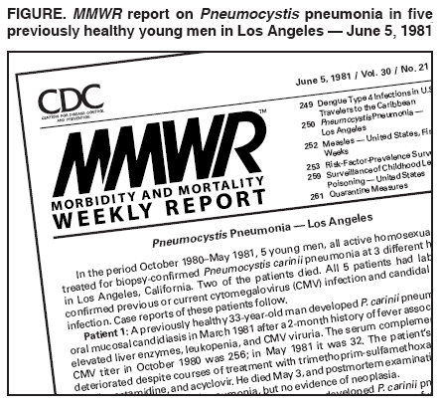
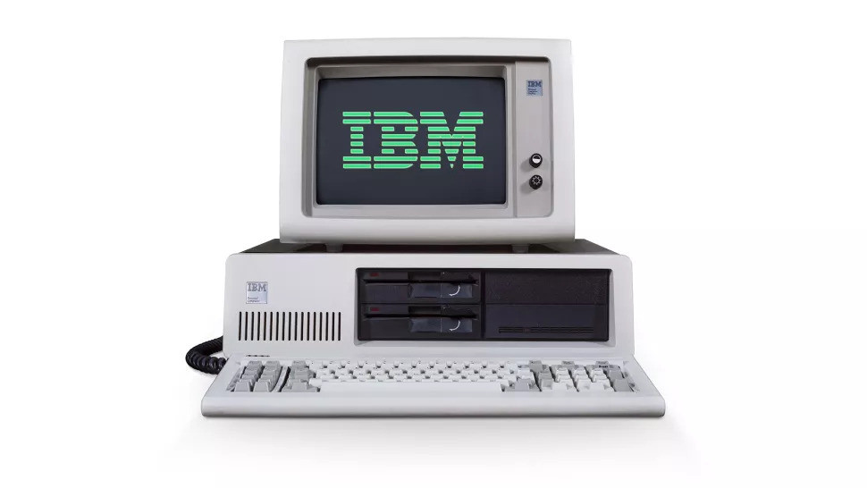
PLEASE AVOID:
“Grand mal”
“Petite mal”
Last used: 1981!

Slide 12
Step 2: Determine Seizure Type
https://www.ilae.org/guidelines/definition-and-classification/operational-classification-2017/ilae-2017-classification-of-seizure-types-checklist
Notes:
First Divide into: focal vs generalized
Motor vs non-motor

Slide 13
Examples of seizures
Generalized
Motor
Tonic*
Atonic*
Clonic*
Tonic-Clonic
Myoclonic
Myoclonic-atonic
Non-Motor
Absence
Atypical Absence
Myoclonic
Eyelid Myoclonic
Focal
Motor
Tonic*
Automatism
Atonic*
Clonic*
Epileptic Spasms
Myoclonic*
Hyperkinetic
Non-Motor
Autonomic
Behavioral Arrest
Behavioral
Sensory
Emotional
Notes:
Tonic – video 2
Hyperkinetic: video 8 Automatism: shows likely right temporal. Oral and right arm automatisms

Slide 14
Epilepsy: Back to the Definition
“At least two unprovoked seizures separated by more than 24 hours
OR one unprovoked (or reflex) seizure, coupled with a probability of further seizures that is similar to the general recurrence risk (at least 60%) after two unprovoked seizures projected over the next decade
i.e. one seizure AND risk factors for epilepsy
OR seizure consistent with an epilepsy syndrome”¹
One seizure? Does not meet criteria? → discuss and watch
^{Meet these? → TREAT!}

Slide 15
Step 3: Determine Epilepsy Type
Focal
Generalized
Combined
Lennox Gastaut
Dravet syndrome
Other epileptic encephalopathies
Unknown
Many diagnosis start here
Each Type responds to different medication
Notes:
Unknown: for those without a clear onset by seizure type and

Slide 16
Anti-Seizure Medications
Broad Spectrum
(Focal + Generalized)
Levetiracetam (Keppra)
Clobazam
Lacosamide^
Lamotrigine**
Felbamate
ethosuximide+
Perampanel (Fycompa)
Phenobarbital
Valproic acid
topiramate
zonisamide
Narrow Spectrum
(Focal Only)
Breviracetam* (Briviact)
Carbamezapine*
Cenobamate (Xcorpi)
Eslicarbazepine (Aptiom)
Gabapentin
pregabalin
Oxcarbazepine
Phenytoin
Tiagabine
vigabatrin
NOT indicated for generalized epilepsy!
^: not proven for absence seizures
*: suggested for generalized but not proven
**: suggested but not proven for absence seizure
+ONLY for absence seizures

Slide 17
First Treatment steps
Unknown Epilepsy Type
Levetiracetam
Zonisamide
Topiramate
Lacosamide
lamotrigine
Child bearing age female
Levetiracetam
Lamotrigine
Lacosamide
Zonisamide
AVOID:
Topiramate, valproic acid, carbamezapine, phenytoin, phenobarbital → teratogenic
Valproic acid, carbamezapine, topiramate (high dose), phenobarbital, primidone → drug drug interactions, interfere with OCP
Valproic acid → weight gain, interactions with estrogen, teratogenic, etc

Slide 18
First Treatment steps (continue)
Focal seizures
Levetiracetam
Easy to titrate
Side effects: depression, irritability, psych, sleep problems
Lacosamide
Easy to titrate
Side effects: dizziness, diplopia, cognitive, imbalance
Monitor: PR prolongation
Oxcarbazepine
Monitor Na
Lamotrigine
Slow titration → risk for SJS, rash

Slide 19
Medications to Avoid
Phenobarbital
Side effects: sedation, falls, enzyme inducer, risk for osteoporosis, cognitive slowing
Teratogenic
Increase risk for ID and dementia
Phenytoin
Side effects: sedation, falls, enzyme inducer, risk for osteoporosis, cognitive slowing
Irreversible side effects: neuropathy, cerebellar degeneration/atrophy, osteoporosis
Other side effects: tremor, ataxia, imbalance, osteoporosis, gingival hyperplasia, pancytopenia
Carbamezapine (caution)
Teratogenic
Enzyme inducer → reduces efficacy of itself, other medications, risk for osteoporosis
Risks: imbalance, ataxia, hyponatremia

Slide 20
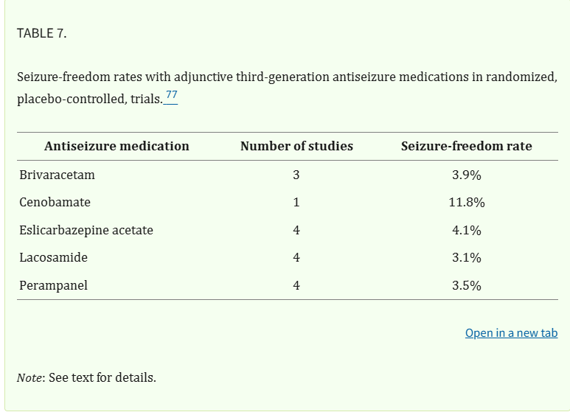
Goals and Outcomes
Treatment goal: seizure freedom
Consultation with neurology = essential
Epilepsy Monitoring Unit (EMU) referral
Characterize spells – confirm seizures
Determine seizure localization and semiology
Confirm appropriate clinical recognition
Outcomes and chance of seizure freedom¹⁰
First ASM: 50-60% seizure freedom
Second ASM: 15- 25% (65 – 85%)
Persistent seizures: 70-80%
Refractory epilepsy
Failure of two well tolerated and appropriately dosed medication
Possible exception: cenobamate (Xcorpi)*¹¹
Next step: neurostimulation or surgery
Schmitz B, Lattanzi S, Vonck K, Kälviäinen R, Nashef L, Ben-Menachem E. Cenobamate in refractory epilepsy: Overview of treatment options and practical considerations. Epilepsia Open. 2023 Dec;8(4):1241-1255. doi: 10.1002/epi4.12830. Epub 2023 Oct 3. PMID: 37743544; PMCID: PMC10690671.

Slide 21
Refractory epilepsy
Focal:
Surgery
Neurostimulation
Vagal Nerve Stimulator (VNS)
Deep Brain Stimulation (DBS)
Responsive Neurostimulator (RNS)
Generalized
Neurostimulation:
VNS
RNS or DBS? → Trials pending!

Slide 22
Vagal Nerve Stimulator (VNS)¹⁴
Peripheral stimulation of the left vagal nerve
Open loop system
FDA approved 1997
Indications: focal epilepsy
Off label: generalized epilepsy
Benefits
Seizure reduction: 50%
Depression
Side effects: hoarseness, coughing, laryngeal paresthesias, laryngismus, dyspnea
Caution:
Can provoke or exacerbate sleep breathing disorders (OSA)

Slide 23
Deep Brain Stimulation (DBS)
SANTE trial (2015)¹²
FDA approved focal epilepsy 2018
Electrodes in bilateral thalami
Anterior nucleus (ANT) – original target
Centromedian nuclear (CMT)
Potential target for generalized, LGS epilepsy
Failure two well tolerated medications
Focal epilepsy
Outcomes:^{13, 14}
Seizure reduction: 49 – 75%
Improves over time
Side effects: infection, paresthesias depression, subjective cognitive dysfunction
Caution: can temporarily worsen depression
In patients with pre-existing depression
Depression and cognition improve over time

Slide 24
Responsive Neurostimulation (RNS)¹⁸
Closed loop system
Detects and stimulates seizure foci
“seizure defibrillator”
Programmed over 2-5 years
Precision care
Depth electrodes or strip cortical electrodes
Indication:
Focal epilepsy with two or less foci
Focal epilepsy not amenable to resection
Responder rate: 44 – 66% seizure reduction
Benefits: good battery life, responder rate, no mood effect
Side effects: implantation effects, bleeding, infection

Slide 25
References
Fisher RE, Acevedo C, Arzimanoglou A, et al. ILAE official report: a practical clinical definition of epilepsy. Epilepsia 2014;55:475-482. doi:10.1111/epi.12550
Classification of the epilepsies by the International League Against Epilepsy. Scheffer IE, et al, Epilepsia.10 © 2017 International League Against Epilepsy
Fisher RS, van Emde Boas W, Blume W, et al. Epileptic seizures and epilepsy: definitions proposed by the International League Against Epilepsy (ILAE) and the International Bureau for Epilepsy (IBE). Epilepsia 2005;46(4):470–472. doi:10.1111/j.0013-9580.2005.66104.
Wirrell, Elain, MD. Evaluation of First Seizure and Newly Diagnosed Epilepsy. Continuum Neurology. Epilepsy p. 230-260, April 2022, Vol.28, No.2, doi: 10.1212/CON.0000000000001074
Continuum (Minneap Minn) 2025;31(1, Epilepsy):14-37
Webb J, Long B, Koyfman A. An Emergency Medicine-Focused Review of Seizure Mimics. J Emerg Med. 2017 May;52(5):645-653. doi: 10.1016/j.jemermed.2016.11.002. Epub 2016 Dec 19. PMID: 28007363.
2019 Neurology Residents Scholar Program (NRSP) – for outline and figures
Egesa IJ, Newton CRJC, Kariuki SM. Evaluation of the International League Against Epilepsy 1981, 1989, and 2017 classifications of seizure semiology and etiology in a population-based cohort of children and adults with epilepsy. Epilepsia Open. 2022; 7: 98–109. https://doi.org/10.1002/epi4.12562
https://www.ilae.org/guidelines/definition-and-classification/operational-classification-2017/ilae-2017-classification-of-seizure-types-checklist
Brodie MJ, Barry SJ, Bamagous GA, Norrie JD, Kwan P. Patterns of treatment response in newly diagnosed epilepsy. Neurology. 2012;78(20):1548–1554. https://doi.org/10.1212/WNL.0b013e318 2563b19.
Schmitz B, Lattanzi S, Vonck K, Kälviäinen R, Nashef L, Ben-Menachem E. Cenobamate in refractory epilepsy: Overview of treatment options and practical considerations. Epilepsia Open. 2023 Dec;8(4):1241-1255. doi: 10.1002/epi4.12830. Epub 2023 Oct 3. PMID: 37743544; PMCID: PMC10690671.
Salanova V, Witt T, Worth R, Henry TR, Gross RE, Nazzaro JM, Labar D, Sperling MR, Sharan A, Sandok E, Handforth A, Stern JM, Chung S, Henderson JM, French J, Baltuch G, Rosenfeld WE, Garcia P, Barbaro NM, Fountain NB, Elias WJ, Goodman RR, Pollard JR, Tröster AI, Irwin CP, Lambrecht K, Graves N, Fisher R; SANTE Study Group. Long-term efficacy and safety of thalamic stimulation for drug-resistant partial epilepsy. Neurology. 2015 Mar 10;84(10):1017-25. doi: 10.1212/WNL.0000000000001334. Epub 2015 Feb 6. PMID: 25663221; PMCID: PMC4352097.
Zangiabadi N, Ladino LD, Sina F, Orozco-Hernández JP, Carter A, Téllez-Zenteno JF. Deep Brain Stimulation and Drug-Resistant Epilepsy: A Review of the Literature. Front Neurol. 2019 Jun 6;10:601. doi: 10.3389/fneur.2019.00601. PMID: 31244761; PMCID: PMC6563690.
Wong S, Mani R, Danish S. Comparison and Selection of Current Implantable Anti-Epileptic Devices. Neurotherapeutics. 2019 Apr;16(2):369-380. doi: 10.1007/s13311-019-00727-2. PMID: 31062294; PMCID: PMC6554379.

